Slide 1

PROCESS MINING VIRTUAL INTERNSHIP
by
R.MAHITHA REDDY
Roll No. 214G1A3251
Department of Computer Science and Engineering (Data Science)
Srinivasa Ramanujan Institute of Technology
(Affiliated to JNTUA & Approved by AICTE) (Accredited by NAAC with ‘A’ Grade & Accredited by NBA (EEE, ECE & CSE)
Rotarypuram Village, B K Samudram Mandal, Ananthapuramu – 515701.
2023 - 2024

Slide 2

Contents
Course Objective
Introduction
Technology
Applications
Modules
Real Time applications
Learning outcomes
GitHub Link
Queries

Slide 3
Course objectives
Participants will gain a comprehensive understanding of process mining's versatile applications across industries.
Real-world examples will highlight its role in boosting efficiency, compliance, and decision-making in organizations.
Able to know how and where Process Mining works.

Slide 4
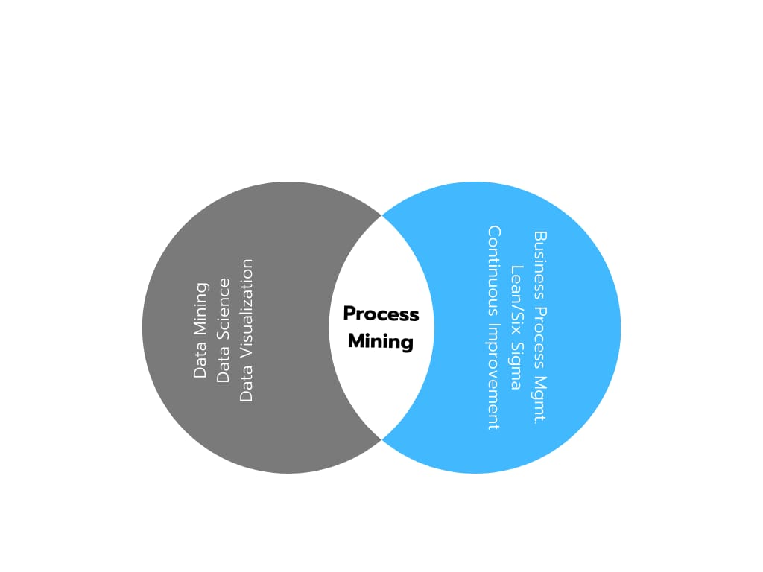
Introduction
Process mining is a family of techniques relating the fields of data science and process management to support the analysis of operational processes based on event logs.
Process mining techniques use event data to show what people, machines, and organizations are really doing. Process mining provides novel insights that can be used to identify the execution paths taken by operational processes and address their performance and compliance problems.
Process Discovery identifies the business processes,
maps and analyzes an organization’s existing business
processes,uncovers the process steps .

Slide 5
Contd....
Process Discovery identifies the business processes, maps and analyzes an organization’s existing business processes, uncovers the process steps that they are not aware of, and realizes process deviations.
It is a technique in the field of process management that supports the analysis of business processes based on event logs and drives improved efficiency, effectiveness and compliance through its insights.
The real world examples of process mining include procurement, order management, compliance, intelligent automation, digital transformation, KPI reporting, accounts payable, accounts receivable, auditing, IT development, service management, logistics, and many more.

Slide 6
Technology
Process mining is a data science technique that involves using data mining and process analytics to uncover, validate, and enhance workflows within organizations
1. Event Data Handling:
Enterprise & IoT: Collecting data from systems and IoT devices.
Storage: Efficiently managing data with databases and big data tools.
2. Automated Process Understanding:
Mining Algorithms: Deriving process models from event data.
Model Notations: Using standardized notations for representation.
3. Visual Insights:
Mining Software: Tools for process visualization and analysis.
Custom Dashboards: Creating tailored visuals for specific insights.

Slide 7
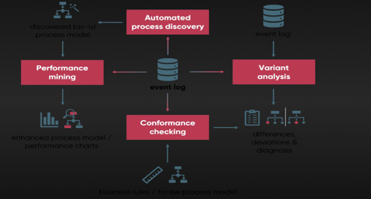
Contd....
(Automated) Process discovery is a primary technique and implies extracting and visualizing process models from an event.
Conformance checking compares the actual process with a predefined model to discover deviations. So, it’s used to check if the reality conforms to an existing pattern.

Slide 8
Applications
Finance: Enhancing loan approval processes, fraud detection, and compliance monitoring.
Manufacturing: Optimizing production workflows and identifying quality control issues.
Customer Service: Streamlining customer support processes and enhancing customer experiences.
Healthcare: Improving patient care pathways and hospital operations.
Supply Chain Management: Analyzing the end-to-end supply chain process for better resource allocation and inventory management.

Slide 9
Modules
Data Extraction:
This is the first step in process mining. Data is collected from various sources, such as IT systems, databases, and logs. This data includes information about the activities, timestamps, users, and other relevant details of the process being analyzed.
Preprocessing and Data Transformation:
Raw data is often messy and complex. In this module, the data is cleaned, organized, and transformed into a suitable format for analysis. Irrelevant or incomplete data is removed, and the remaining data is structured to prepare it for further processing.

Slide 10
Contd....
Conformation Checking:
After the process is discovered, this module compares the actual process as recorded in the data with the expected or ideal process. Any deviations, anomalies, or non-compliance with predefined rules or benchmarksare highlighted. This helps organizations identify areas where the process isn't being followed correctly.
Process Discovery:
This module is the heart of process mining. It involves creating a visual representation of the process flow based on the collected data. This representation is often in the form of process maps, flowcharts, or graphs that show how different activities are connected and the sequence in which they occur.

Slide 11
Write PQL Queries
PQL, or Process Query Language, is a language used in the field of process mining to query and analyze event data captured from business processes. PQL allows you to extract valuable insights from event logs, discover patterns, and gain a better understanding of how processes are executed. Some of the PQL queries used in process mining are:
1.Selecting Events: The most basic form of a PQL query involves selecting events from your event log. Events can be filtered based on various attributes such as timestamp, activity, resource, case ID, etc.
2.Filtering Cases: You can focus on specific cases by filtering based on their unique case IDs.
3.Aggregations and Grouping: You can aggregate data and group events by various attributes to analyze patterns.
4.Temporal Patterns: Analyzing time-related patterns is essential in process mining.
5.Joining Events: You can join events from multiple logs or based on different attributes.

Slide 12
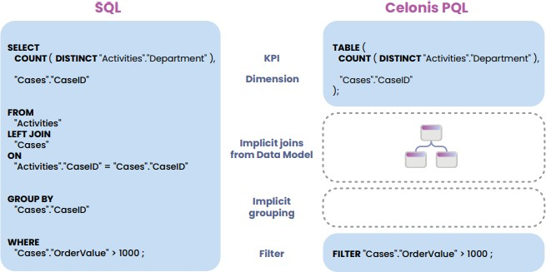
SQL vs PQL
Celonis PQL provides a wide range of different operators which can be combined to answer complex business questions. The following list gives an overview of the most important classes of operators.
Comparison of SQL and PQL

Slide 13
Real Time Applications
Supply Chain Management: In logistics and manufacturing, process mining can track the movement of goods in real time, helping identify delays, optimize routes, and ensure timely deliveries.
Healthcare Workflow Optimization: Process mining can be used to monitor patient flows in hospitals, clinics, and healthcare systems. It helps identify bottlenecks, streamline patient care, and ensure efficient resource allocation.
IT Incident Management: In the IT sector, process mining can analyze real-time data from systems and applications to quickly detect and resolve incidents, reducing downtime and maintaining smooth operations.

Slide 14
Learning Outcomes
Get to know about new Technology.
Learnt basics of the Process mining
Able to learn how it works.
Real time Senario is learnt.

Slide 15
Git Hub Dashboard

Slide 16
Any Queries?

Slide 17
Thank You!!!

